Slide 1
Biomechanical Testing of Rabbit Radius/Ulna and Humerus Bones With Various Fixation Techniques to Determine Overall Strength and Stiffness
Ella Davis
Holmdel High School
Animal Science

Slide 2
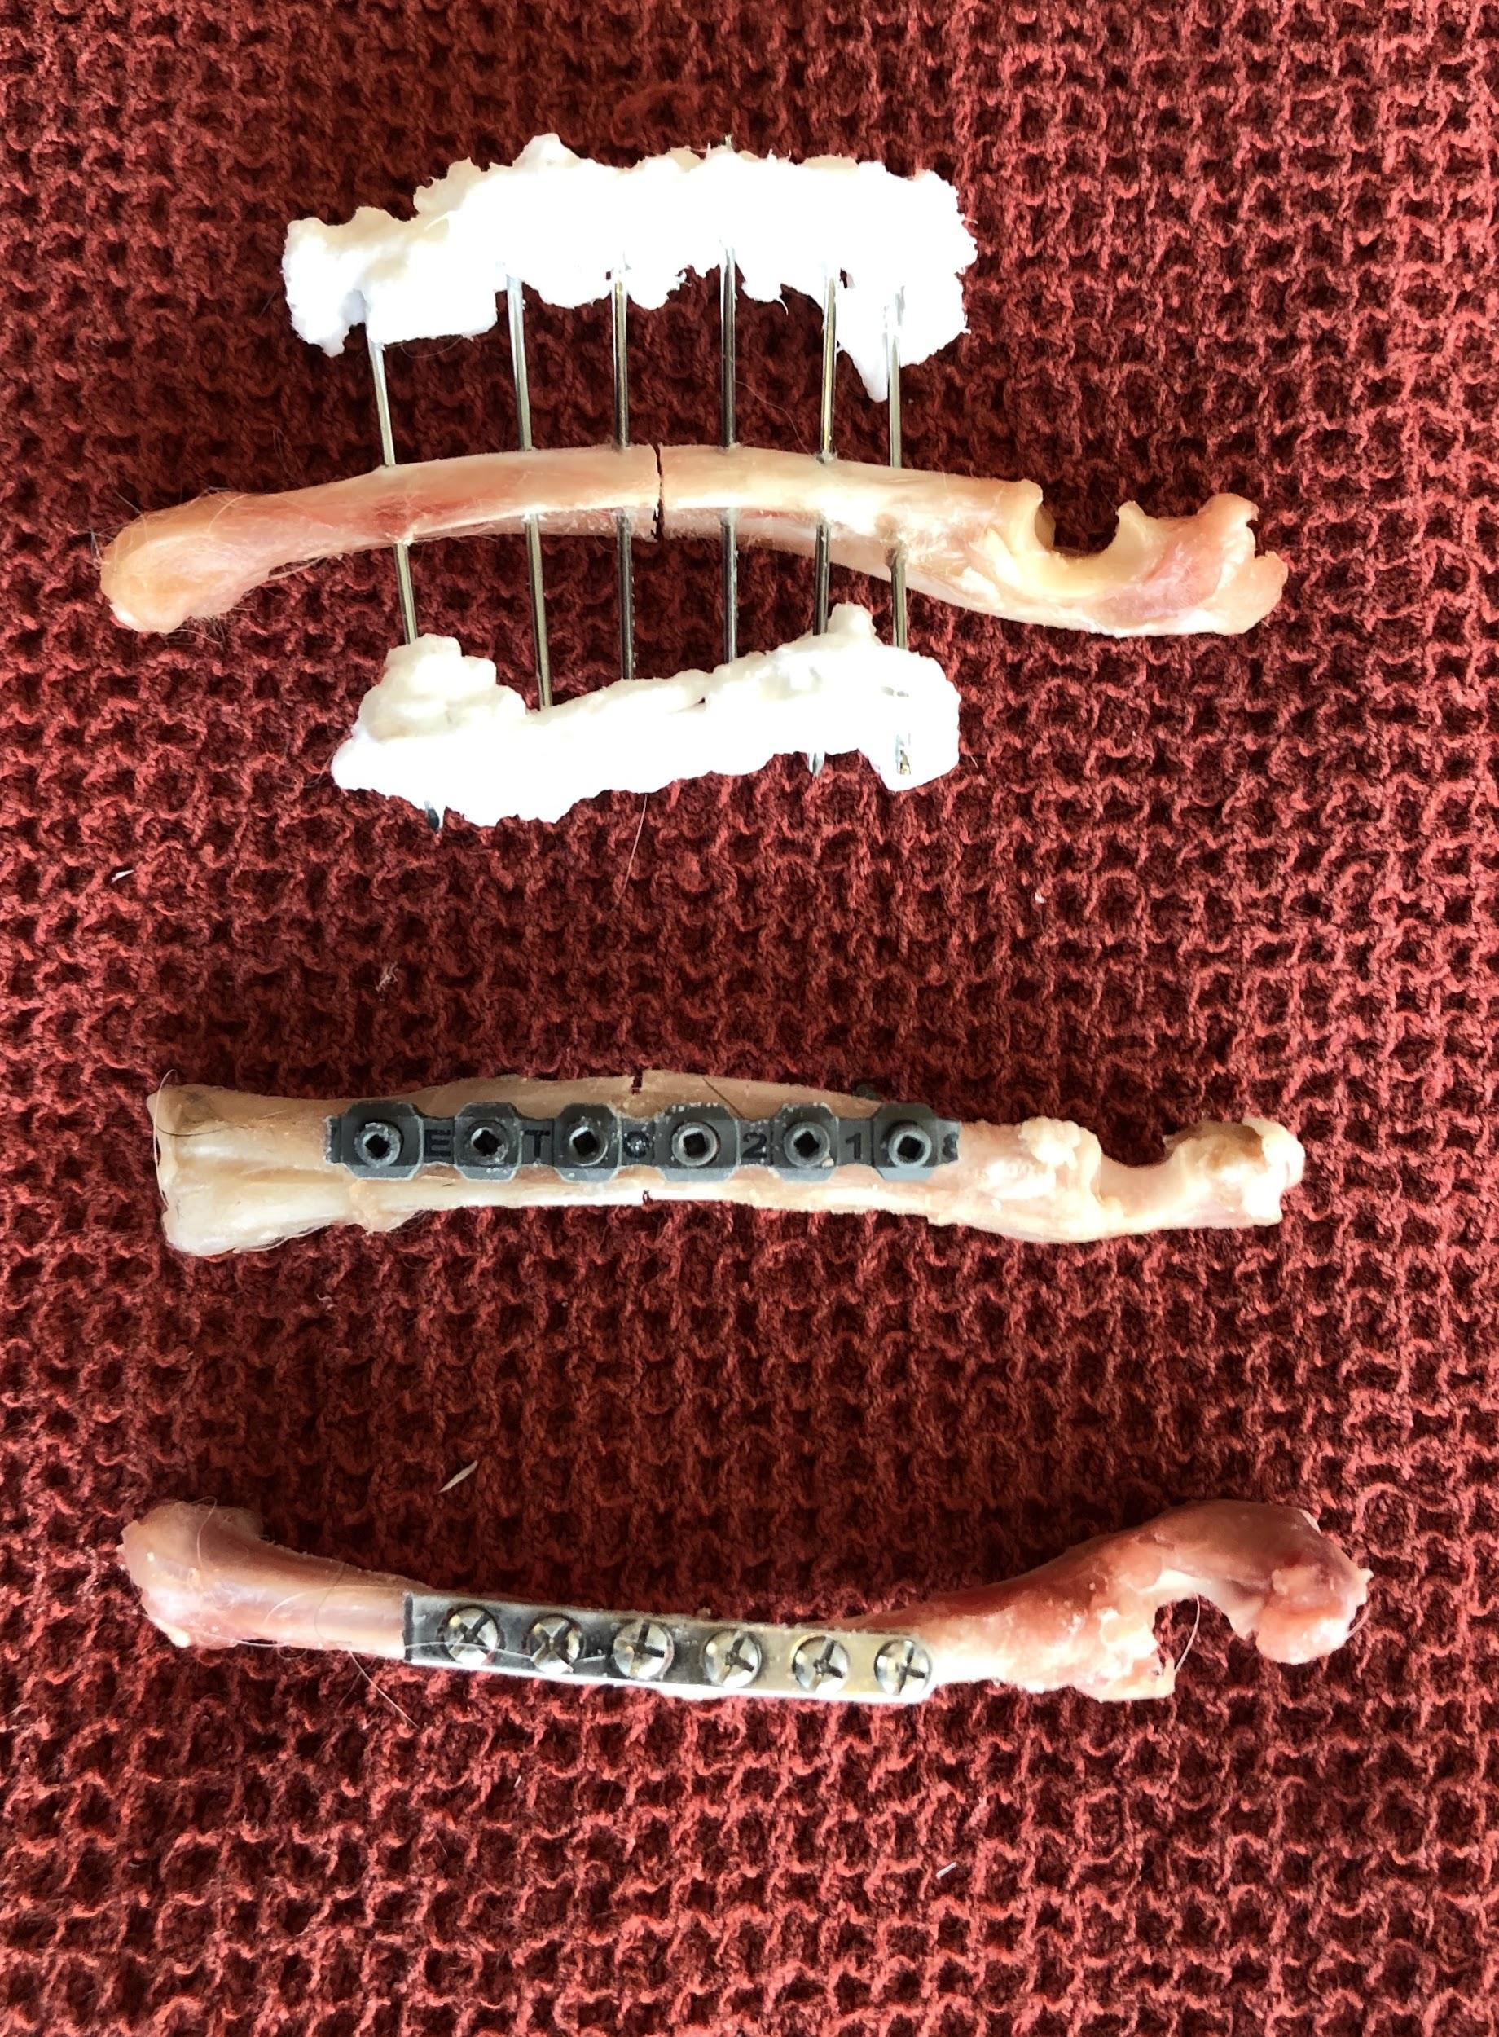
Rabbit Bones
It is common for rabbits to fracture bones.
Rabbit bones are small, brittle, and difficult to repair.
Traditional repairs involve:
Dynamic compression plate with screws
Locking plate with screws
External fixator
Compression plate Locking plate External fixator

Slide 3
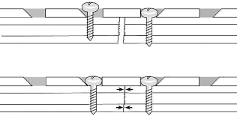
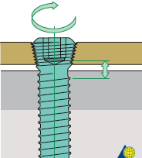
Fixation Types
Dynamic compression plates are put into place with screws which engage the bone and push the plate to the surface of the bone.
Locking plates and screws are put into place with screws which engage both the bone and the plate with threads on the screw head.
External fixators uses pins which are drilled into the bone and attached to a firm rod or other construct which is on the outside of the skin.
Compression Plates Overview
Essay Writing Services:plate and screw osteosynthesis
Type-I External Fixation Kit

Slide 4
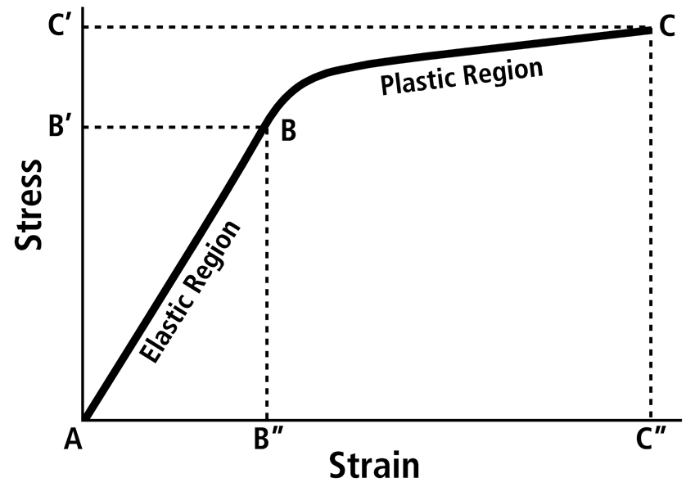
Strength vs. Stiffness
Testing both strength and stiffness is important when looking at how well a surgical implant will withstand normal walking after repair.
Strength is the maximum force applied at the point of failure
Stiffness is the slope of the curve in the elastic region

Slide 5
Hypothesis and Objective
The hypothesis of the study was that when testing the strength and stiffness of a fractured bone fixed with an external fixator, plate, or locking plate, the strength and stiffness of the bone fixed with a locking plate will most closely approximate the strength of an intact bone.
The null hypothesis was that when testing in four-point bending, the locking plate would not most closely approximate the strength and stiffness of the intact bone.
The purpose of this study was to determine the optimal fixation technique of rabbit radius/ulna and humerus bones by examining the overall strength and stiffness of intact bones and bones after fracture and repair.

Slide 6
Materials and Methods
10 rabbits that died or were euthanized at the Red Bank Veterinary Hospital for non-orthopedic problems were collected with owner’s permission for use in the study.
All rabbits were similar size, the bones were measured, and x-rays were taken to ensure the bones were healthy and had similar dimensions.
In total 20 radius/ulna and 20 humerus were used for the study.
Bones were randomly assigned into 4 groups
Control (intact bones with no fixation)
Dynamic compression plate repair
Locking plate repair
External fixator repair

Slide 7
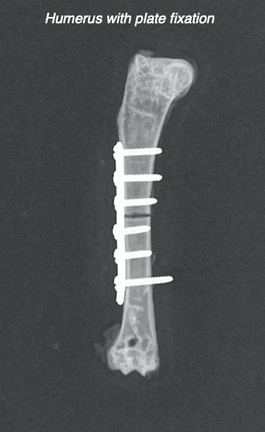
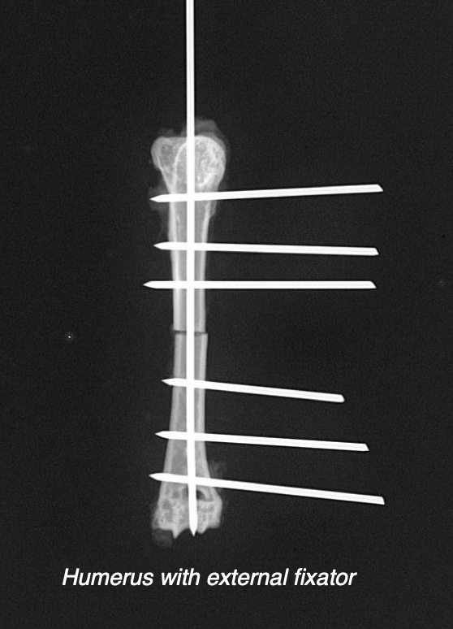
Fixators
Plate fixation was performed with stainless steel Synthes 1.5 veterinary cuttable plates and 1.5-millimeter stainless steel screws.
Locking plate fixation was performed using OsteoCertus 1.5 titanium locking plates and 1.5-millimeter titanium screws.
External fixators were constructed using 1.5-millimeter stainless steel pins placed in a type two configuration in the radius and a type one configuration with an intramedullary pin in the humerus with Vet-Lite thermoplastic casting material to construct the side bars.

Slide 8
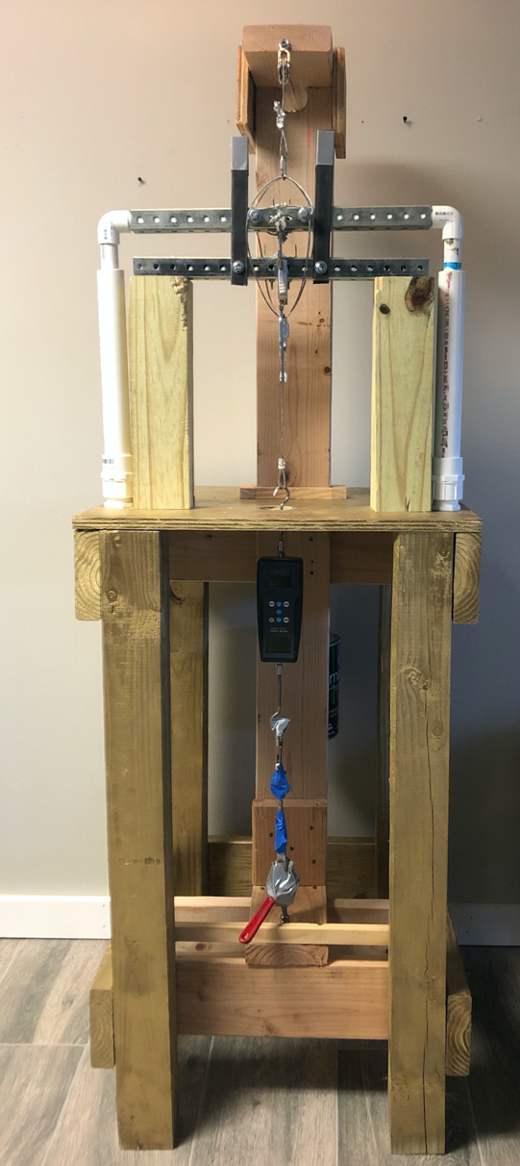
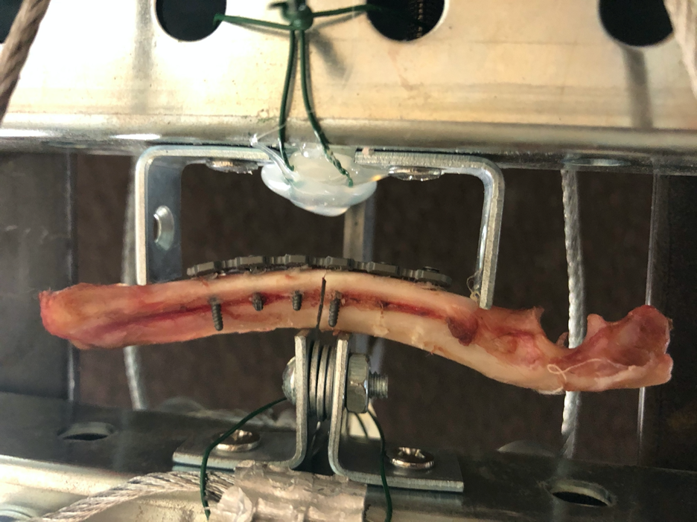
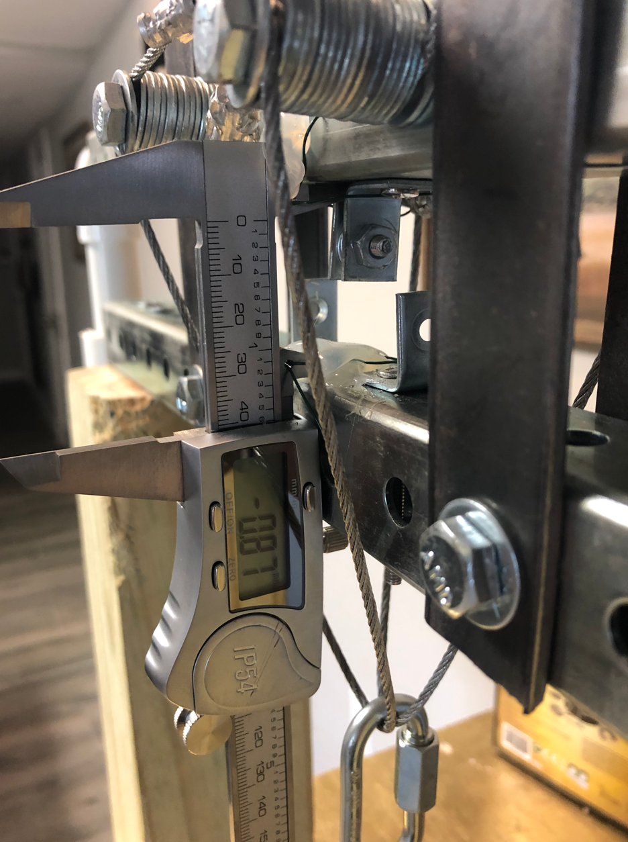
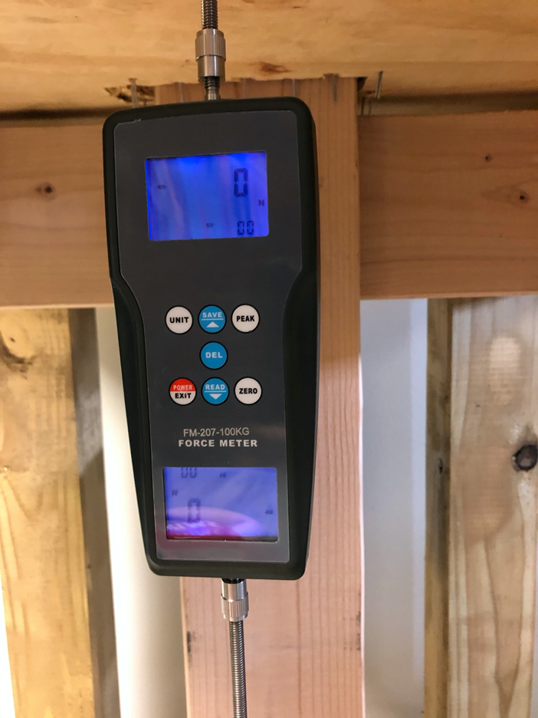
Biomechanical Testing Device
Bones were tested in 4 point bending with a homemade biomechanical testing device.
Radius/Ulna being tested in 4 point bending
Rubeder Electronic Vernier Calipers IP54
Sulmile Digital Force Gauge FM-207
Biomechanical testing device

Slide 9
Method of Testing
Force was applied to the bones at a constant rate of 1 mm/minute.
Recordings were made of both force and displacement to generate a stress strain curve.
The difference in strength/stiffness between groups was determined using an unpaired student's t-test with significance set at a p-value of less than 0.05.

Slide 10
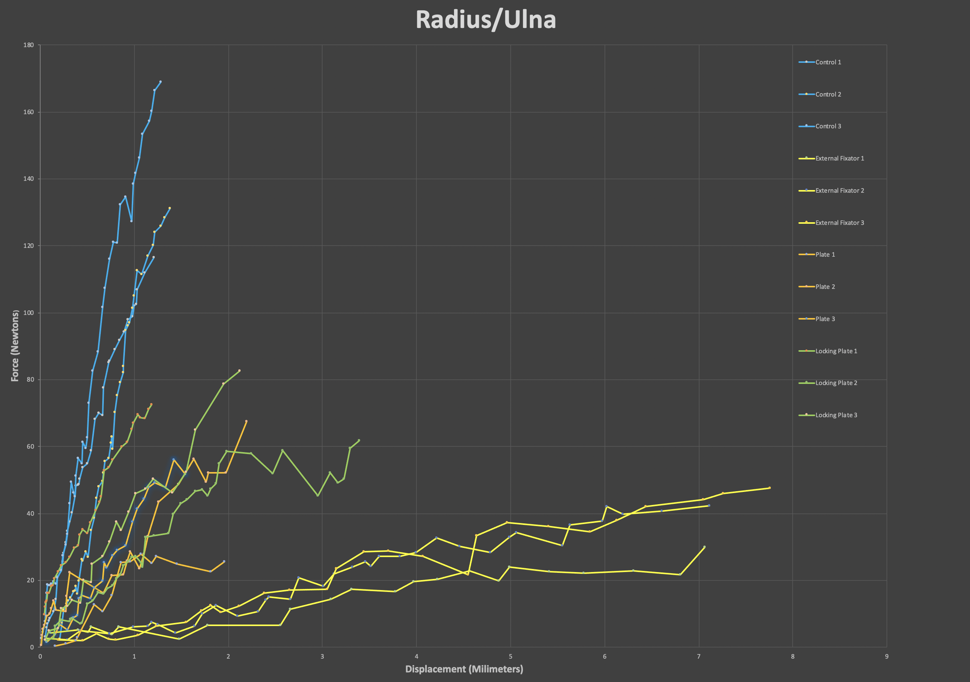
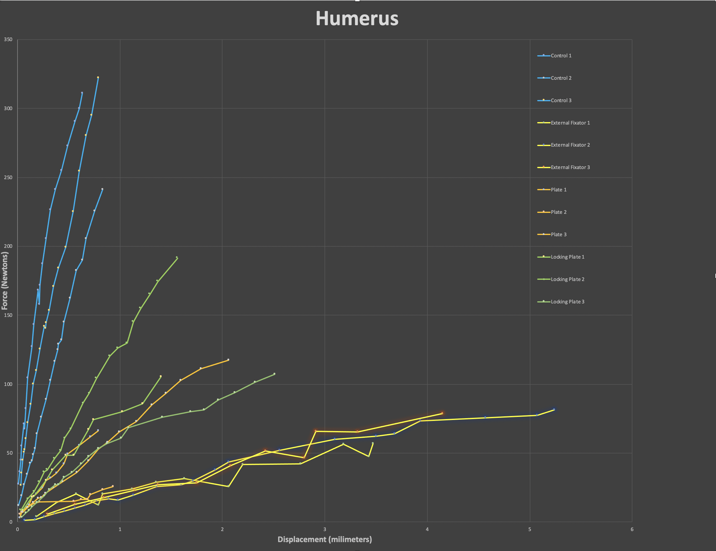
Results
Stress/strain curves were generated for radius/ulna and humerus for each construct.

Slide 11
Results (Radius strength)
There was a statistical difference between the strength of the control and the strength of each repair group. There was no statistically significant difference between the strength of any of the repair groups, although the strength of the locking plate approached a significant difference from the external fixator (p=0.09).
The average strength of each of the 5 trials in newtons (radius/ulna)
Control | 158.44 * (significantly stronger than locking plate, plate, or external fixator)
Locking Plate | 68.46
Plate | 58.96
External Fixator | 49.46

Slide 12
Results (Radius stiffness)
All fixation groups were less stiff than the control group. The locking plate and plate were stiffer than the external fixator (p < 0.01). There was no difference between the stiffness of the plate and the locking plate (p=0.91).
The average displacement in micrometers/newton of each of the 5 trials in newtons (Radius/ulna)
Control | 982.9* (significantly stiffer than locking plate, plate, or external fixator)
Locking Plate | 2154.0 *(significantly stiffer than external fixator)
Plate | 3521.3*(significantly stiffer than external fixator)
External Fixator | 13095.4

Slide 13
Results (Humerus strength)
There was a statistical difference between the strength of the control and the strength of each repair group. The locking plate was stronger than both the plate (p=0.01) and the external fixator (p=0.02). There was no statistically significant difference between the strength of the plate and the external fixator (p=0.66).
The average strength of each of the 5 trials in newtons (humerus)
Control | 251.04 * (significantly stronger than locking plate, plate, or external fixator)
Locking Plate | 134.44 * (significantly stronger than plate or external fixator)
Plate | 58.52
External Fixator | 76.80

Slide 14
Results (Humerus stiffness)
There was no difference in the stiffness between the control and the plate (p=0.87) or between the control and the locking plate (p=0.16). The external fixator was less stiff than the control (p < 0.01). The locking plate was stiffer than the external fixator (p=0.01). There was no difference between the stiffness of the plate and the locking plate (p=0.35) or the stiffness between the plate and external fixator (p=0.47).
The average displacement in micrometers/newton of each of the 5 trials in newtons (Radius/ulna)
Control | 2717.6* (significantly stiffer than external fixator)
Locking Plate | 1812.1 * (significantly stiffer than external fixator)
Plate | 2904.3
External Fixator | 5262.1

Slide 15
Conclusions
The radius/ulna and humerus were able to be successfully repaired using each of the techniques.
When tested in four-point bending, the intact bones and the three repairs yielded fairly consistent strength and stiffness measurements within each group.
The locking plate was the strongest fixation technique in the humerus and in the radius (results in the radius did not reach statistical significance).
The locking plate was the stiffest fixation (least amount of displacement/newton) in the radius/ulna and humerus (statistically significant when compared to external fixator).
None of the repairs were as strong as the intact bones.
Rabbit bones fixed with a locking plate most closely approximate characteristics of intact bones and therefore should be the fixation of choice when repairing rabbit fractures.

Slide 16
Future Studies
This same study can be performed on the femur and tibia of rabbits to determine the optimal fixation techniques for those bones. Also, using these same techniques, the metals used to create the plates and screws can be analyzed separately to determine the optimal substances to perform fixation and to improve the materials.

Slide 17
Bibliography
Aguila, A.Z. et al, In vitro biomechanical comparison of limited contact dynamic compression plate and
locking compression plate, Veterinary Comparative Orthopedics and Traumatology, 4, 220-226, 2005.
Compression Plates Overview, www2.med.wayne.edu/diagRadiology/RSNA2003/Compression_Plates_Overview.htm.
Essay Writing Services: Affordable and Reliable - Essay Tips Razer on Romance Writers: These Broads Have No Time for
Nonsense Plate and Screw Osteosynthesis, securidoor.org/index.php/writer/10332/.
Massie, Anna M et at, Effects of hole diameter on torsional mechanical properties of the rabbit femur,
Veterinary Comparative Orthopedics and Traumatology, 32, 51-58, 2019.
Rich, Gregory A, Rabbit Orthopedic Surgery, Veterinary Clinics of North America, 5, 157-168, 2002.
Shunmugasamy, Vasanth C et al, High strain rate response of rabbit femur bones, Journal of
Biomechanics, 43, 3044-3050, 2010.
“Type-I External Fixation Kit, Small - Jorgensen LabsJorgensen Labs.” Jorgensen Labs,
www.jorvet.com/product/type-i-external-fixation-kit-small/.

